Slide 1
Efficient algorithms for the scaled indexing problem
Biing-Feng Wang, Jyh-Jye Lin, and Shan-Chyun Ku
Journal of Algorithms 52 (2004) 82–100
Presenter: Yung-Hsing Peng
Date: 2005.03.22

Slide 2
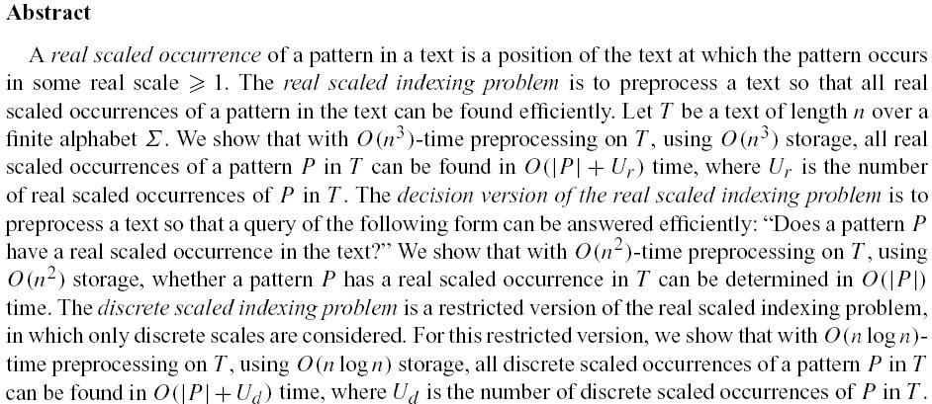

Slide 3
Example for the problem
Let T = a⁵c⁶a¹c¹a⁴b³ (run length coding)
P1 = a²c
P2 = c¹a¹b¹
δ is the scaling function with parameter k
If k = 2, we have δ₂(P1) = a⁴c², δ₂(P2) = c²a²b²
→δ₂(P1) can be found in T, so P1 is a valid pattern
In this example, P2 is not a valid pattern since it failed to every k.

Slide 4
Algorithm for Discrete Scaling
For every positive integer k, construct a new string T_{k} for T
take x^{y} for example, if y is divisible by k, then replace it by x^{(y/k)}, else replace it by x^{(y/k)}$ x^{(y/k)}
ex: T = a⁵c⁶a¹c¹a⁴b³ (with max repeat m = 6)
T₁ = a⁵c⁶a¹c¹a⁴b³
T₂ = a²$a²c³$$a²b¹$b¹
T₃ = a¹$a¹c²$$a¹$a¹b¹
T₄ = a¹$a¹c¹$c¹$a¹$
T₅ = a¹c¹$c¹$$$$
T₆ = $c¹$$$$
Theorem: Let P be a valid pattern, then P must be find in
T₁$T₂$T₃……$T_{m}

Slide 5
An Efficient Method to Build T_{k}
Use T_{k-1} to compute T_{k} (use the index I_{k})
ex: T = a⁵c⁶a¹c¹a⁴b³ (with max repeat m = 6)
1 2 3 4 5 6 (index)
I₁ = {1,2,3,4,5,6}
T₁ = a⁵c⁶a¹c¹a⁴b³ I₂ = {1,2,5,6}
T₂ = a²$a²c³$$a²b¹$b¹ I₃ = {1,2,5,6}
T₃ = a¹$a¹c²$$a¹$a¹b¹ I₄ = {1,2,5}
T₄ = a¹$a¹c¹$c¹$a¹$ I₅ = {1,2}
T₅ = a¹c¹$c¹$$$$ I₆ = {2}
T₆ = $c¹$$$$ I₇ = {}
For any I_{k}, there are at most (n/k) elements
→ |I₁| + |I₂| + |I₃| + …. |I_{m}| = nlogm
→ T₁$T₂$T₃$...$T_{m} can be built in O(nlogm)

Slide 6
Time Complexity of Discrete Scaling
Lemma: T₁$T₂$T₃…$T_{m} can be built in O(nlogm)
Lemma: For each T_{k}, its length is O(n/k)
→ The length of T₁$T₂$T₃…$T_{m} is
O(n/1 + n/2 + n/3 + ….+ n/m) = O(nlogm)
→ The suffix tree of T₁$T₂…$T_{m} can be built in O(nlogm)
where n is the length of T and m is the max repeat length of characters in T

Slide 7
Algorithm for the Decision Version of the Real Scaling (1/2)
For every critical real number k, construct a new string T_{k} for T
Since the input pattern P is discrete in its run length coding
We can find all critical k by division.
Ex: a⁵c⁶a¹c¹a⁴b³ → (1) divided by 1 → {5, 6, 1, 4, 3}
(2) divided by 2 → {2.5, 3, 2, 1.5}
(3) divided by 3 → {1.66, 2, 1.33, 1}
(4) divided by 4 → {1.25, 1.5, 1}
(5) divided by 5 → {1, 1.2}
(6) divided by 6 → {1}
If m is the max repeats in P, then the set Γ(T) of critical k can be
computed by the union of (1)~(m)

Slide 8
Algorithm for the Decision Version of the Real Scaling (2/2)
For all critical k in Γ(T) , construct a new string T_{k} for T
take x^{y} for example, if y is k-invertible, then replace it by x^{Ф(y, k)}, else replace it by x^{Ф(y, k)}$ x^{Ф(y, k)}
where Ф(y, k) means the largest integer r that floor(k*r) ≤ y
ex: T = a⁵c⁶a¹c¹a⁴b³ (with max repeat m = 6)
if k = 1.5, then T_{k} = a³$a³c⁴$$a³b²
Theorem: Let P be a valid pattern, then P must be find in
T_{k1}$T_{k2}$T_{k3}……$T_{kz}, where z is the number of critical k
In above example, if k = 1.7 then T_{k} would be a³c⁴$$a²$a²b²
→ The position of δ_{1.7}(a³c⁴) in T is different from that of δ_{1.5}(a³c⁴) in T
→ This algorithm can only solve the decision version of real scaling.

Slide 9
Time Complexity of Decision Version of Real Scaling
Lemma: In worst case, the total number of critical k is O(n)
Lemma: Each T_{ki} can be computed in O(n)
Lemma: T_{k1}$T_{k2}$T_{k3}……$T_{kz} can be built in O(n²)

Slide 10
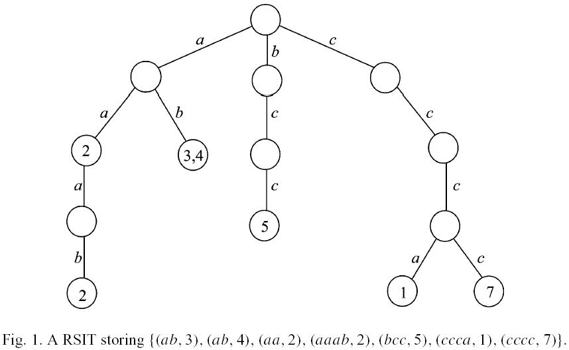
Algorithm for the Real Scaling (1/4)
Core: Generate all valid patterns and use them to build a Real Scale Indexing Tree (RSIT) to speed up searching.

Slide 11
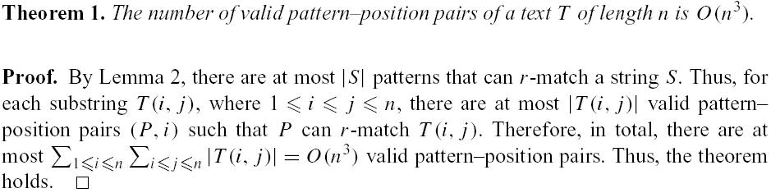
Algorithm for the Real Scaling (2/4)
The upper bound for the number of all valid patterns
Since there are O(n³) patterns, straightforward implementations would take O(n⁴) in order to insert all patterns into RSIT. This paper gives an O(n³) algorithm for doing so.

Slide 12
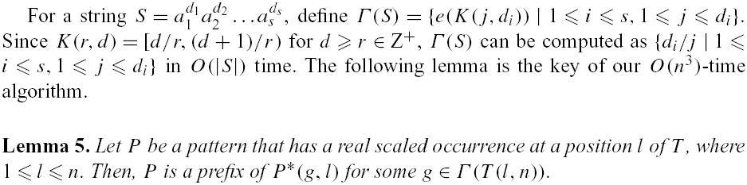
Algorithm for the Real Scaling (3/4)
P*(g, l) → used to shrink the longest substring start from l, which can be shrink by g
EX: T = a a a a b b b c c c a a a a, P = b c
l = 4
P*(3,4) = b c a (means the red region shrinks by 3)
→ P is a prefix of P*(3,4)

Slide 13
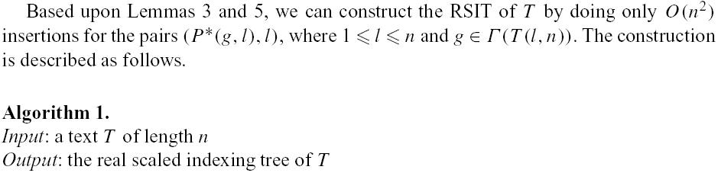
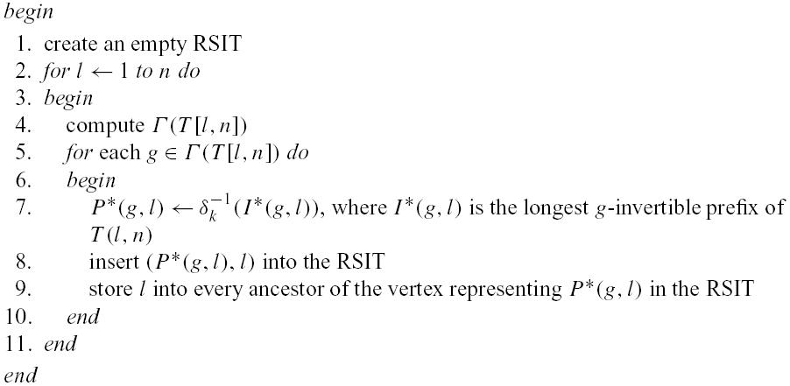
Algorithm for the Real Scaling (4/4)

Slide 14
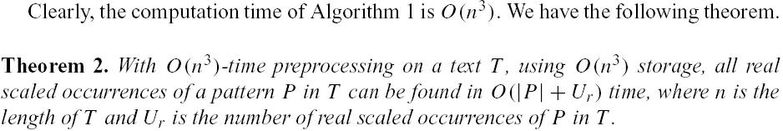
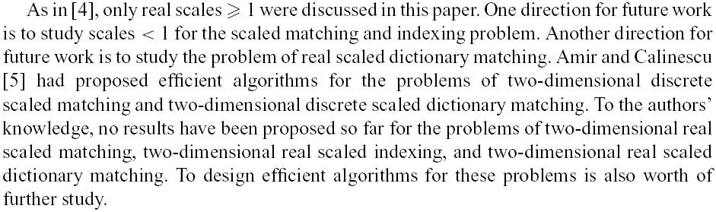
Conclusion of Real Scaled Indexing Problem

